Slide 1


Virtual Vending Machine Webapp
Project Mini Viva Presentation
By Issa Aboobaker, ia252

Slide 2
Motivations for The Project
General Aim: Create an exact simulation of a real Vending Machine with additional features and the scope to implement it as a real service.
Real World Applications and Uses:
  Businesses are moving towards digital services
  Convenience: Users can browse and purchase items online
  Commercialisation: Digital blueprint for vending machines, replace physical machines, hybrid implementation.
Enhanced User Experience: Better UI and Real-Time feedback.
Personal: Technical Skills Development - Building a full web application, handling payments/transactions and Software Design principles.

Slide 3
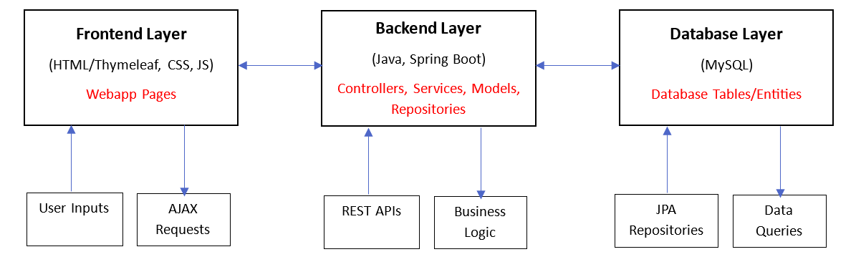
Overview
Virtual Vending Machine Simulation
Full stack webapp
MVC Design Pattern
Backend: Java, SpringBoot, Gradle
Frontend: HTML/Thymeleaf, CSS, JavaScript
Database: MySQL

Slide 4
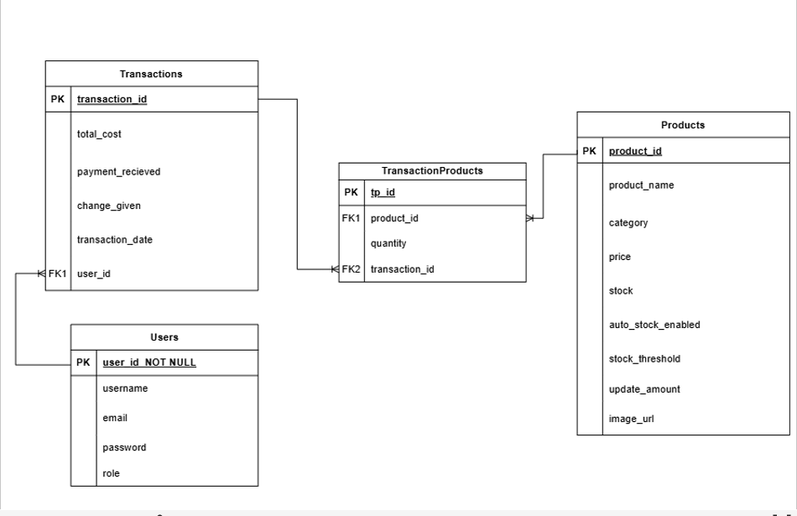
Database ERD

Slide 5

Main Vending Machine Features
Interactive Vending Machine UI, with a visually engaging theme
Keypad Input System
Dynamic Cart display with control features
Stock Management: real-time stock checks and item availability alerts
Realistic Coin Payment Simulation (with animations and effects)
Item view (with images)
Receipt Viewing (and downloading)
Item categorization and category filtering
Smart Recommendations (from a ML based algorithm)
Instructions: Found throughout the UI and in the User Manual

Slide 6



Additional Features
Enhanced Item Viewing
User accounts (Login and Register pages)
Google OAuth2 Login and Guest Login
Card Payments (Stripe Checkout)
Transaction History viewing (with querying/filtering and sorting features)
Analytics Page (with personalized and interactive visuals)
Auto restocking
Admin Controls (update stocks, manage auto restock settings)

Slide 7

Evaluation: Successes
Successfully completed the system, meeting the aims and objectives
All functional requirements were achieved
Created a visually appealing, responsive and usable UI
Good coding practices
Contains all base vending machine features
Advanced features: analytics and smart recommendations algorithm
Demonstrated strong understanding of full stack webapp development
Documentation: Detailed progress reports in both the Project Log and GitLab commit messages.

Slide 8

Evaluation: Difficulties
AJAX Implementation for: fetching backend product data, stock checking and dynamically updating page display
UI Design: Usability, Responsiveness, Styling (trial and error)
Combining and connecting frontend and backend
Transaction Logic
Database Setup and Management
Recommendation Algorithm
Stripe integration
Error handling (errors occur throughout)
Non-functional requirement not fully met: “19. Testing and Validation” (could’ve added more Junit tests)

Slide 9

Evaluation: Potential Improvements
More Products to choose from and better categorization
Improved Smart Recommendations Algorithm
Better Analytics: more visuals, customizable graphs
Expand Admin Controls: add/remove Products, applying discounts
Additional animations and visual enhancements (item and change dispensing)
Returns/Refunds
Tracking Change

Slide 10
Conclusion/Summary
Virtual Vending Machine Webapp
Simulation of real vending machines
Potential commercial applications
Contains standard vending machine features and additional features
Overall successful
Many difficulties but were overcome
There are many potential future improvements

